Slide 1
Deep Learning for Computer Vision
Convolution Networks

Slide 2
Topics
Understanding convolutional neural networks (convnets)
Using data augmentation to mitigate overfitting
Using a pretrained convnet to do feature extraction
Fine-tuning a pretrained convnet
Visualizing what convnets learn and how they make classification decisions

Slide 3
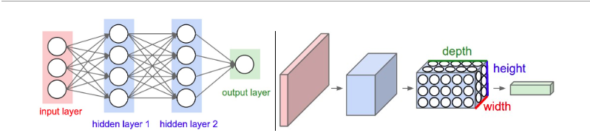
Architecture
Ref: https://cs231n.github.io/convolutional-networks/#pool

Slide 4
Convnets
A ConvNet is made up of Layers. Every Layer has a simple API: It transforms an input 3D volume to an output 3D volume with some differentiable function that may or may not have parameters.
Convolution layer
Pooling layer
Fully-connected layer

Slide 5
Live Example
http://cs231n.stanford.edu/

Slide 6
A Basic Convnet
library(keras)
model <- keras_model_sequential() %>%
layer_conv_2d(filters = 32, kernel_size = c(3, 3), activation = "relu", input_shape = c(28, 28, 1)) %>%
layer_max_pooling_2d(pool_size = c(2, 2)) %>%
layer_conv_2d(filters = 64, kernel_size = c(3, 3), activation = "relu") %>%
layer_max_pooling_2d(pool_size = c(2, 2)) %>%
layer_conv_2d(filters = 64, kernel_size = c(3, 3), activation = "relu")
A convnet takes as input tensors of shape (image_height, image_width, image_channels) (not including the batch dimension)
Example MNIST
Model listing 5.1

Slide 7
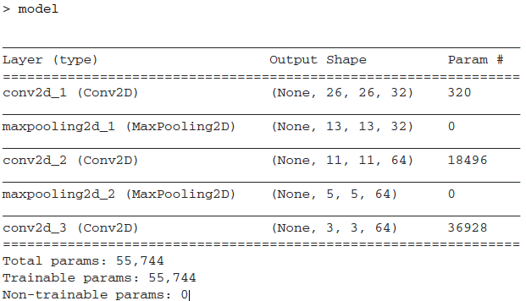
Architecture
Outputs are 3D tensors
Width and Height dimensions shrink
Number of channels is controlled by the first argument, filters

Slide 8
Output Layer
The next step is to feed the last output tensor (of shape (3, 3, 64)) into a densely connected classifier network:
model <- model %>%
layer_flatten() %>%
layer_dense(units = 64, activation = "relu") %>%
layer_dense(units = 10, activation = "softmax")

Slide 9
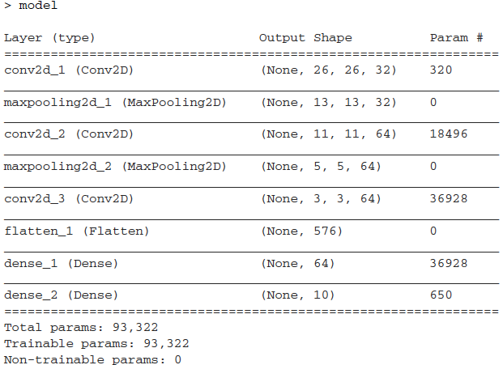
Final Model

Slide 10
Training and Evaluation
Look at example 5.1

Slide 11
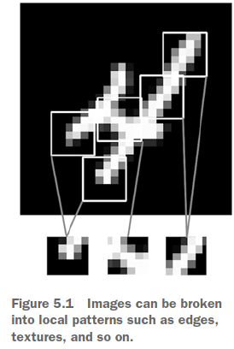
The Convolution Operation
What do layer_conv_2d and layer_max_pooling_2d do?
The fundamental difference between a densely connected layer and a convolution layer is this: dense layers learn global patterns in their input feature space (for example, for an MNIST digit, patterns involving all pixels), whereas convolution layers learn local patterns. in the case of images, patterns found in small 2D windows of the inputs. In the previous example, these windows were all 3x3.

Slide 12
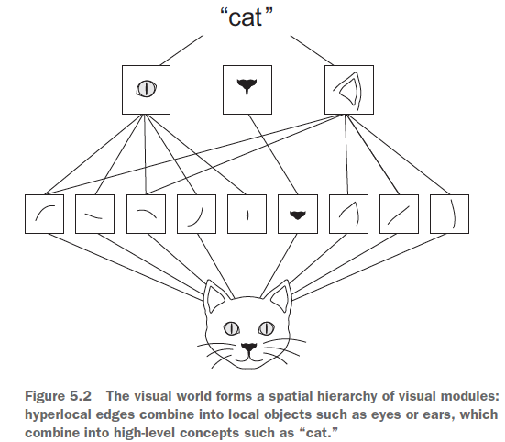
Key Characteristics
The patterns they learn are translation invariant
They can learn spatial hierarchies of patterns

Slide 13
Convolutions
They operate over 3D tensors, called feature maps, with two spatial axes (height and width) as well as a depth axis (also called the channels axis). For an RGB image, the dimension of the depth axis is 3
The convolution operation extracts patches from its input feature map and applies the same transformation to all of these patches, producing an output feature map. The output feature map is still a 3D tensor. It has height and width, though the depth can be arbitrary, because the output depth is a parameter of the layer (filter in our code).
Filters encode specific aspects of the input data: at a high level, a single filter could encode the concept “presence of a face in the input,” for instance.

Slide 14
Filters
In the MNIST example,
Input feature map of size (28, 28, 1) -> output feature map of size (26, 26, 32)
There are 32 filters over its input.
Each 32 output channels contain a 26x26 grid of values, which is a response map of the filter over the input, indicating the response of that filter pattern at different locations in the input.
Thus, a feature (filter) map at every depth dimension is the 2D spatial map of the response of the filter over the input.

Slide 15
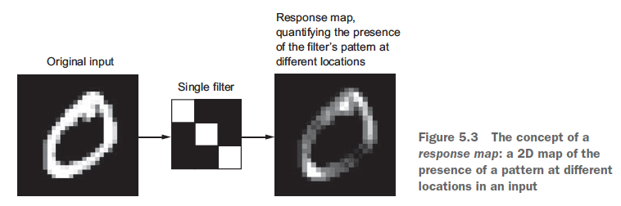
Filters (Example)

Slide 16
Key Parameters - Convolutions
Size of the patches extracted from the inputs —These are typically 3 x 3 or 5 x 5 (c(window_height, window_width))
Depth of the output feature map—The number of filters computed by the convolution (output_depth)

Slide 17
How Does a Convolution Work?
By sliding these windows of size 3 x 3 or 5 x 5 over the 3D input feature map, stopping at every possible location, and extracting the 3D patch of surrounding features (shape (window_height, window_width, input_depth)).
Each such 3D patch is then transformed (via a tensor product with the same learned weight matrix, called the convolution kernel ) into a 1D vector of shape (output_depth).
All of these vectors are then spatially reassembled into a 3D output map of shape (height, width, output_depth).
Every spatial location in the output feature map corresponds to the same location in the input feature map

Slide 18
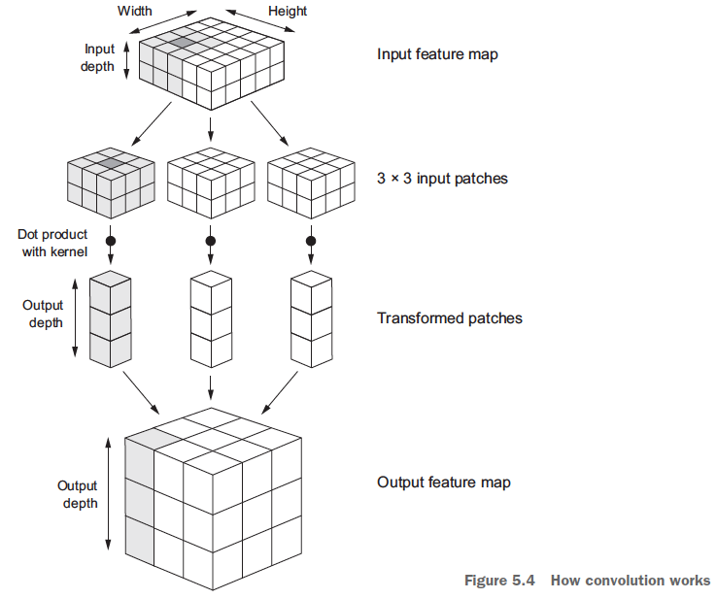
Note that the output width and height may differ from the input width and height.
They may differ for two reasons:
Border effects, which can be countered by padding the input feature map
The use of strides
Here is a good reference to read: https://cs231n.github.io/convolutional-networks/

Slide 19
Border Effects and Padding
Consider a 5x5 feature map. In how many tiles can you center a 3x3 window?

Slide 20
Padding
If you want to get an output feature map with the same spatial dimensions as the input, you can use padding. Padding consists of adding an appropriate number of rows and columns on each side of the input feature map to make it possible to fit center convolution windows around every input tile.
In layer_conv_2d layers, padding is configurable via the padding argument, which takes two values: "valid", which means no padding (only valid window locations will be used); and "same", which means “pad in such a way as to have an output with the same width and height as the input.” The padding argument defaults to "valid".

Slide 21
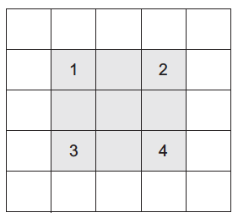
Strides
Convolution so far has assumed that the center tiles of the convolution windows are all contiguous, i.e., a distance of 1. It is possible to have strided convolutions with a distance greater than 1.
Using stride 2 means the width and height of the feature map are downsampled by a factor of 2

Slide 22
Max Pooling
To downsample feature maps, instead of strides, we tend to use the max-pooling operation
Note that in our example, the max-pooling operation halves the feature map.
Max pooling consists of extracting windows from the input feature maps and outputting the max value of each channel. It’s conceptually similar to convolution,except that instead of transforming local patches via a learned linear transformation (the convolution kernel), they’re transformed via a hardcoded max tensor operation.

Slide 23
Max Pooling Explained
6 | 4 | 9 | 5
10 | 0 | 5 | 4
9 | 6 | 2 | 5
5 | 10 | 3 | 10
Hyperparameters
Kernel = 2
Stride = 2
Padding = 0

Slide 24

Output Size
The output size can be easily calculated for any convolution / max pooling operation using the following formula:
Where,
n = input size
P = padding
k = kernel
s = stride
The depth will be equal to the number of filters

Slide 25

Example - Cont.
1 | 1 | 3 | 5 | 3
3 | 5 | 2 | 0 | 8
7 | 6 | 3 | 0 | 2
8 | 6 | 6 | 9 | 0
2 | 3 | 1 | 9 | 2

Slide 26
Channels?
Pooling applies to each channel independently
Number of output channels is equal to number of input channels

Slide 27
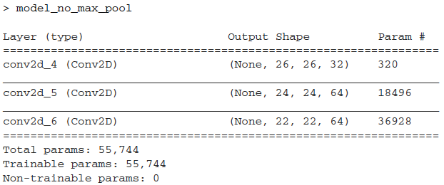
Why Max-Pooling?
model_no_max_pool <- keras_model_sequential() %>%
layer_conv_2d(filters = 32, kernel_size = c(3, 3), activation = "relu",
input_shape = c(28, 28, 1)) %>%
layer_conv_2d(filters = 64, kernel_size = c(3, 3), activation = "relu") %>%
layer_conv_2d(filters = 64, kernel_size = c(3, 3), activation = "relu")

Slide 28
What is Wrong?
It isn’t conducive to learning a spatial hierarchy of features.
We need the features from the last convolution layer to contain information about the totality of the input.
The final feature map has 22 x 22 x 64 = 30,976 total coefficients per sample. This is huge. If you were to flatten it to stick a dense layer of size 512 on top, that layer would have 15.8 million parameters.
In short, the reason to use downsampling is to reduce the number of feature-map coefficients to process, as well as to induce spatial-filter hierarchies by making successive convolution layers look at increasingly large windows (in terms of the fraction of the original input they cover).
Question: Why don’t we use average pooling, for example?

Slide 29
Training a Convnet from Scratch
4000 pictures of cats and dogs
2000 cats, 2000 dogs
2000 pictures for training
1000 pictures for validation
1000 pictures for testing

Slide 30
Approach
Train convnet without regularization (baseline performance)
Data augmentation (to prevent overfitting)

Slide 31
The Issue of Samples

Slide 32
Data
Part of kaggle competition
https://www.kaggle.com/c/dogs-vs-cats/data
The pictures are medium-resolution color JPEGs
The best entries achieved up to 95% accuracy
This dataset contains 25,000 images of dogs and cats (12,500 from each class)
We will create a new dataset containing three subsets: a training set with 1,000 samples of each class, a validation set with 500 samples of each class, and a test set with 500 samples of each class
See program 5.2 for code

Slide 33
Building the Network
The convnet will be a stack of alternated layer_conv_2d (with relu activation) and layer_max_pooling_2d stages
As we are dealing with bigger images and a more complex problem (compared to MNIST), we will have one more layer_conv_2d + layer_max_pooling_2d stage
This serves both to augment the capacity of the network and to further reduce the size of the feature maps so they aren’t overly large when you reach layer_flatten.
The depth of the feature maps progressively increases in the network
(from 32 to 128), whereas the size of the feature maps decreases (from 148 x 148 to 7 x 7).

Slide 34
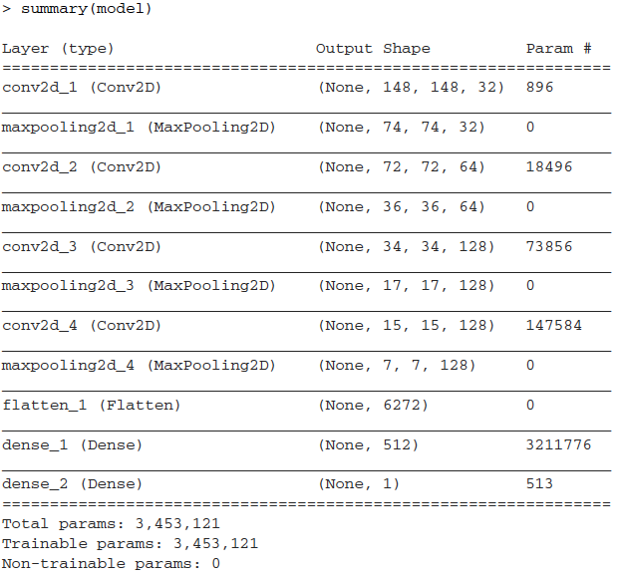
model <- keras_model_sequential() %>%
layer_conv_2d(filters = 32, kernel_size = c(3, 3), activation = "relu",
input_shape = c(150, 150, 3)) %>%
layer_max_pooling_2d(pool_size = c(2, 2)) %>%
layer_conv_2d(filters = 64, kernel_size = c(3, 3), activation = "relu") %>%
layer_max_pooling_2d(pool_size = c(2, 2)) %>%
layer_conv_2d(filters = 128, kernel_size = c(3, 3), activation = "relu") %>%
layer_max_pooling_2d(pool_size = c(2, 2)) %>%
layer_conv_2d(filters = 128, kernel_size = c(3, 3), activation = "relu") %>%
layer_max_pooling_2d(pool_size = c(2, 2)) %>%
layer_flatten() %>%
layer_dense(units = 512, activation = "relu") %>%
layer_dense(units = 1, activation = "sigmoid")

Slide 35
Compilation
model %>% compile(
loss = "binary_crossentropy",
optimizer = optimizer_rmsprop(lr = 1e-4),
metrics = c("acc")
)

Slide 36
Data Preprocessing
Read the picture files.
Decode the JPEG content to RGB grids of pixels.
Convert these into floating-point tensors.
Rescale the pixel values (between 0 and 255) to the [0, 1] interval

Slide 37
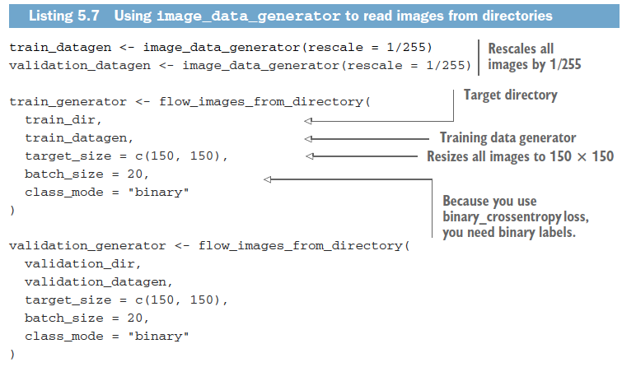
Using image_data_generator()

Slide 38
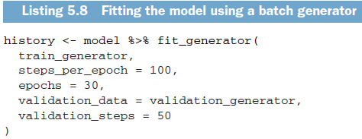
Fitting the Model
We fit the model to the data using the generator by using fit_generator
It expects as its first argument a generator that will yield batches of inputs and targets indefinitely, like this one does.
The fitting process needs to know how many samples to draw from the generator before declaring an epoch over
This is the role of the steps_per_epoch argument
Batches are 20 samples, so it will take 100 batches until you see your target of 2,000 samples

Slide 39
Data Augmentation
In addition to regularization and dropout, one technique to prevent overfitting, specific to computer vision and universally applied is data augmentation.
Overfitting is really a sampling problem
Data augmentation takes the approach of generating more training data from existing training samples, by augmenting the samples via a number of random transformations that yield believable-looking images
The goal is that at training time, your model will never see the exact same picture twice. This helps expose the model to more aspects of the data and generalize better.

Slide 40
Data augmentation configuration via image_data_generator
datagen <- image_data_generator(
rescale = 1/255,
rotation_range = 40,
width_shift_range = 0.2,
height_shift_range = 0.2,
shear_range = 0.2,
zoom_range = 0.2,
horizontal_flip = TRUE,
fill_mode = "nearest
)

Slide 41
Using a Pretrained Convnet
A pretrained network is a saved network that was previously trained on a large dataset, typically on a large-scale image-classification task.
Spatial hierarchy of features learned by the pretrained network can effectively act as a generic model of the visual world,
Portability of learned features across different problems is a key advantage of deep learning compared to many older, shallow-learning approaches, and it makes deep learning very effective for small-data problems.

Slide 42
Example
Large convnet trained on the ImageNet dataset (1.4 million labeled images and 1,000 different classes
ImageNet contains many animal classes, including different species of cats and dogs
We will use the VGG16 architecture
Many such models: Xception, Inception V3, ResNet50, VGG16, VGG19, MobileNet
There are two ways to use a pretrained network: feature extraction and fine-tuning

Slide 43
Feature Extraction
Feature extraction consists of using the representations learned by a previous network to extract interesting features from new samples. These features are then run through a new classifier, which is trained from scratch.
Convnets used for image classification comprise two parts:
Convolution base: pooling and convolution layers
Presence maps of generic concepts
Densely connected classifier
Specific to the problem
Don’t contain spatial information

Slide 44
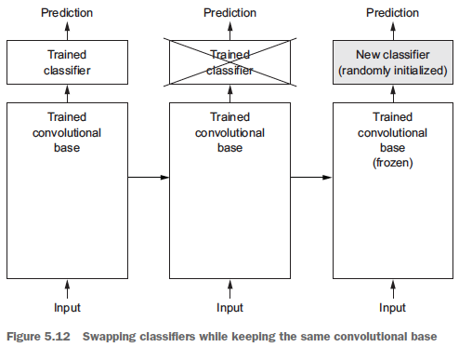
Approach
Layers that come earlier in the model extract local, highly generic feature maps (such as visual edges, colors, and textures)
Layers that are higher up extract more-abstract concepts (such as “cat ear” or “dog eye”).

Slide 45
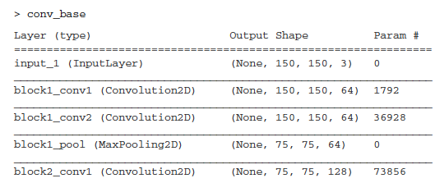
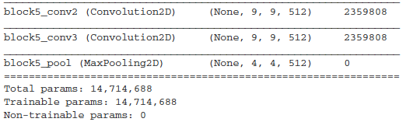
VGG16 Model
library(keras)
conv_base <- application_vgg16(
weights = "imagenet",
include_top = FALSE,
input_shape = c(150, 150, 3)
)

Slide 46
How to Proceed
Running the convolutional base over your dataset, recording its output to an array on disk, and then using this data as input to a standalone, densely connected classifier
Fast, and cheap to run
Will not use data augmentation
Extending the model you have (conv_base) by adding dense layers on top, and running the whole thing end to end on the input data.
Allows data augmentation
Expensive

Slide 47
Fast Feature Extraction With Data Augmentation
Listing 5.3
Training is very fast, because you only have to deal with two dense layers
You reach a validation accuracy of about 90%

Slide 48
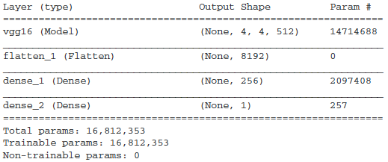
Feature Extraction with Data Augmentation
Much slower and expensive
Intractable on a CPU
Because models behave just like layers, you can add a model (like conv_base) to a sequential model just like you would add a layer.
model <- keras_model_sequential() %>%
conv_base %>%
layer_flatten() %>%
layer_dense(units = 256, activation = "relu") %>%
layer_dense(units = 1, activation = "sigmoid")

Slide 49
Freeze
Before you compile and train the model, it’s very important to freeze the convolutional base.
In Keras, you freeze a network using the freeze_weights()
freeze_weights(conv_base)
Note that in order for these changes to take effect, you must first
compile the model. If you ever modify weight trainability after compilation, you should then recompile the model, or these changes will be ignored
Note that the validation data shouldn’t be augmented!

Slide 50
Fine Tuning
Fine-tuning consists of unfreezing a few of the top layers of a frozen model base used for feature extraction, and jointly training both the newly added part of the model (in this case, the fully connected classifier) and these top layers.
This is called fine-tuning because it slightly adjusts the more abstract representations of the model being reused, in order to make them more relevant for the problem at hand.

Slide 51
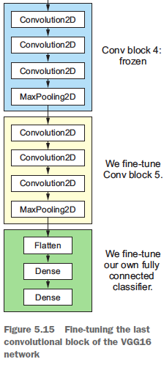
Thus, the steps for fine-tuning a network are as follows:
Add your custom network on top of an already-trained base network.
Freeze the base network.
Train the part you added.
Unfreeze some layers in the base network.
Jointly train both these layers and the part you added.
You'll fine-tune all of the layers from Block3_conv1 on. Why not fine-tune more layers?

Slide 52
Steps
Unfreeze_weights(conv_base, from = "block3_conv1")
Use RMSProp optimizer using a very low learning rate.

Slide 53
Wrapping Up
Convnets are the best type of machine-learning models for computer-vision tasks.
It’s possible to train one from scratch even on a very small dataset, with decent results.
On a small dataset, overfitting will be the main issue. Data augmentation is a powerful way to fight overfitting when you’re working with image data.
It’s easy to reuse an existing convnet on a new dataset via feature extraction. This is a valuable technique for working with small image datasets.
As a complement to feature extraction, you can use fine-tuning, which adapts to a new problem some of the representations previously learned by an existing model. This pushes performance a bit further.

Slide 54
Visualizing what Convnets Learn
The representations learned by convnets are highly amenable to visualization, in large part because they’re representations of visual concepts
A wide array of techniques have been developed for visualizing and interpreting these representations
Visualizing intermediate convnet outputs (intermediate activations)
Visualizing convnets filters
Visualizing heatmaps of class activation in an image
Look at listing 5.4

Slide 55
CloudML and RStudio
https://tensorflow.rstudio.com/tools/cloudml/articles/getting_started.html

